Slide 1
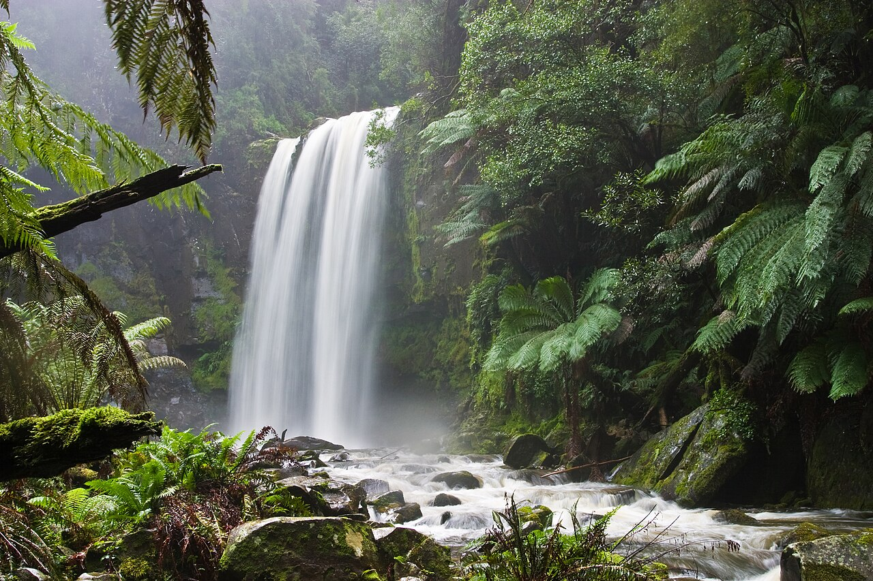
ENVIORNMENT

Slide 2
ENVIONMENTABOUT
The natural environment or natural world encompasses all biotic and abiotic things occurring naturally, meaning in this case not artificial. The term is most often applied to Earth or some parts of Earth. This environment encompasses the interaction of all living species, climate, weather and natural resources that affect human survival and economic activity.[1] The concept of the natural environment can be distinguished as components:

Slide 3
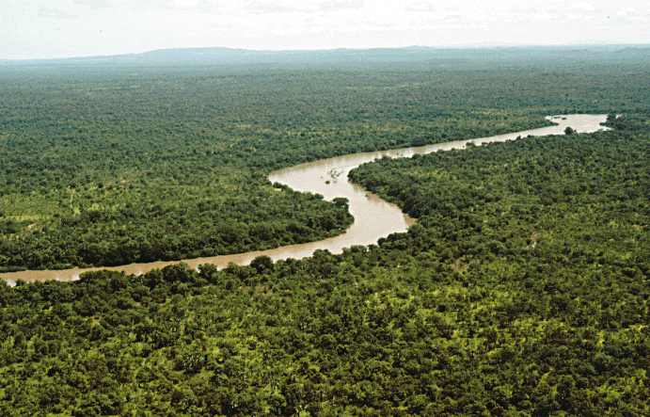
ECO SYSTEM
An ecosystem (also called an environment) is a natural unit consisting of all plants, animals, and micro-organisms (biotic factors) in an area functioning together with all of the non-living physical (abiotic) factors of the environment.[34]

Slide 4
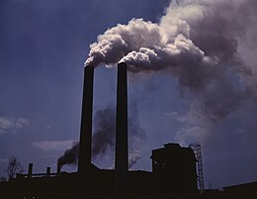
AIR POLLUTION
Air pollution is the contamination of air due to the presence of substances called pollutants in the atmosphere that are harmful to the health of humans and other living beings, or cause damage to the climate or to materials.[1] It is also the contamination of the indoor or outdoor environment either by chemical, physical, or biological agents that alters the natural features of the atmosphere.[1] There are many different types of air pollutants, such as gases (including ammonia, carbon monoxide, sulfur dioxide, nitrous oxides, methane and chlorofluorocarbons), particulates (both organic and inorganic) and biological molecules

Slide 5
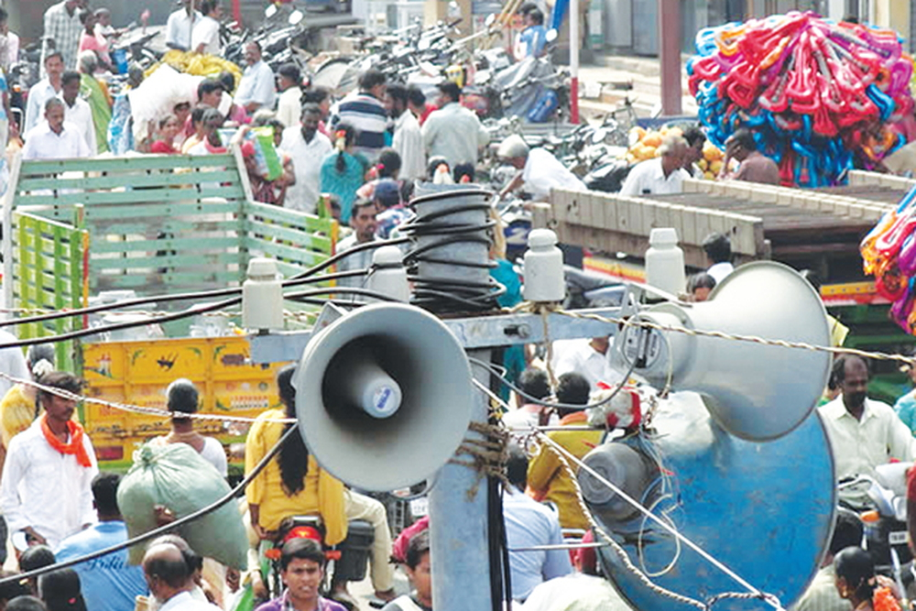
NOISE POLLUTION
pollution, unwanted or excessive sound that can have deleterious effects on human health, wildlife, and environmental quality. Noise pollution is commnoiseonly generated inside many industrial facilities and some other workplaces, but it also comes from highway, railway, and airplane traffic and from outdoor construction activities.

Slide 6
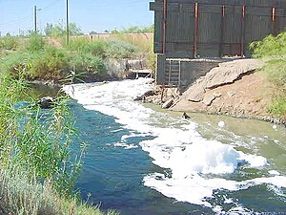
WATER POLLUTION
Water pollution (or aquatic pollution) is the contamination of water bodies, with a negative impact on their uses.[1]: 6 It is usually a result of human activities. Water bodies include lakes, rivers, oceans, aquifers, reservoirs and groundwater. Water pollution results when contaminants mix with these water bodies. Contaminants can come from one of four main sources. These are sewage discharges, industrial activities, agricultural activities, and urban runoff including stormwater.[2] Water pollution may affect either surface water or groundwater. This form of pollution can lead to many problems. One is the degradation of aquatic ecosystems

Slide 7
END

Slide 8
THANK YOU

